Slide 1
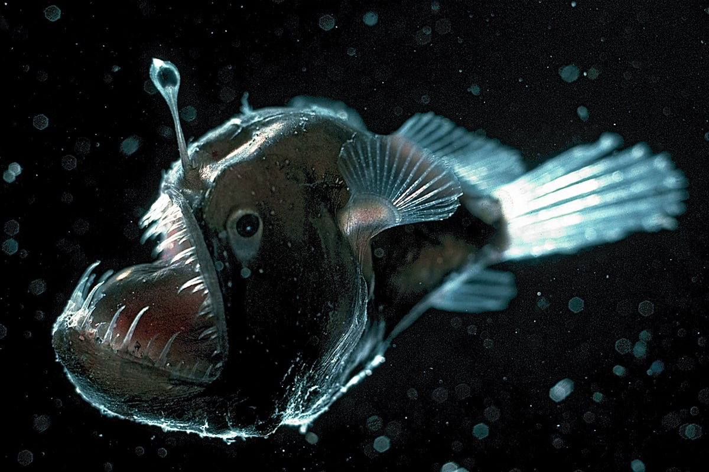
Notes:
anglerfish

Slide 2
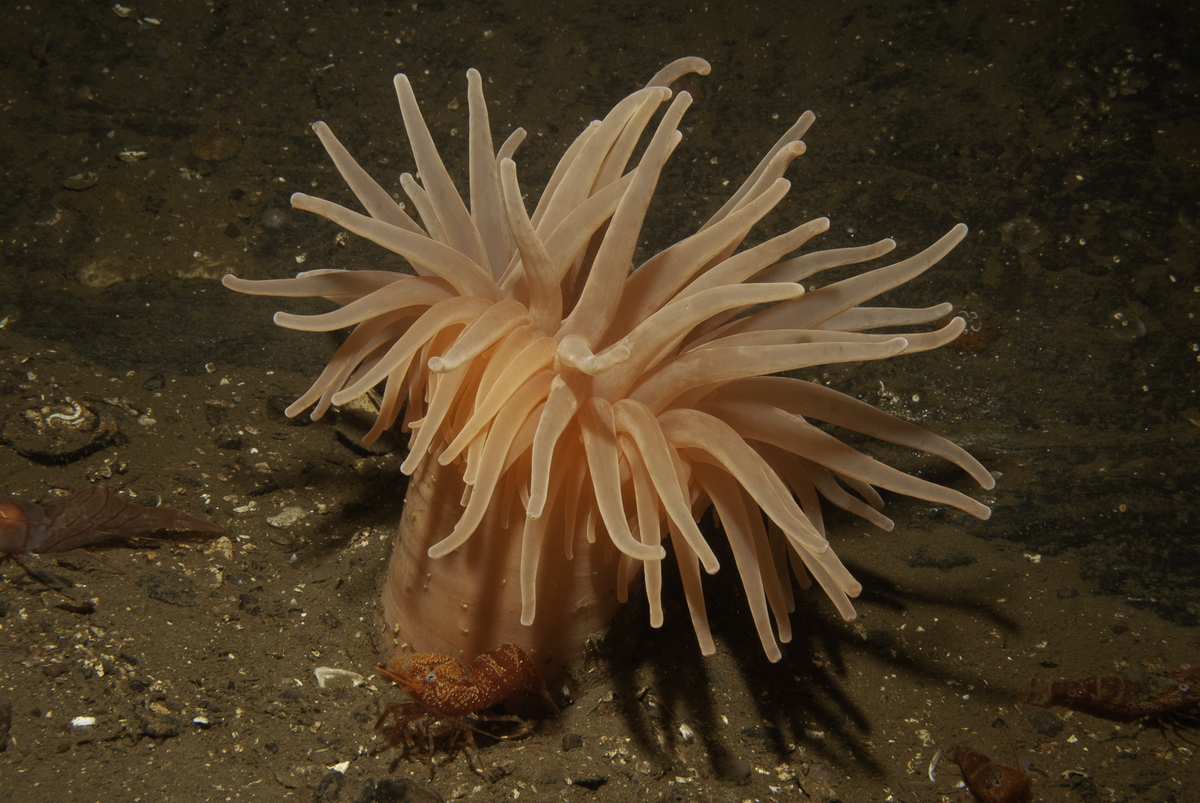
Notes:
Sea anemone

Slide 3
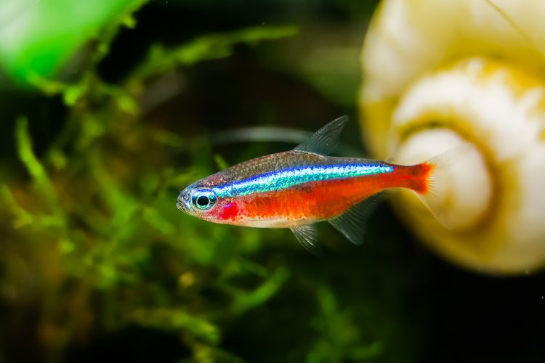
Notes:
Neon tetra

Slide 4

Notes:
Ariel

Slide 5
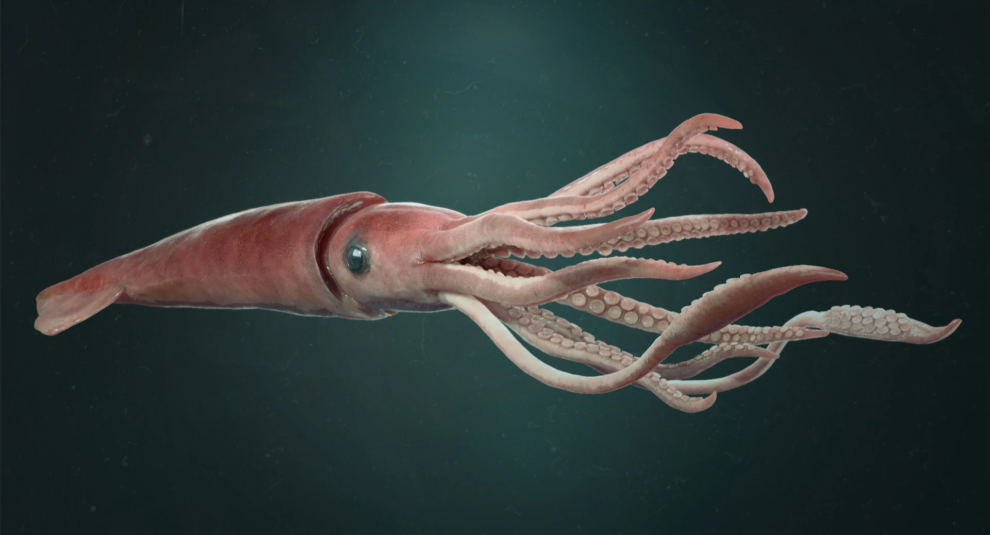
Notes:
Giant squid

Slide 6
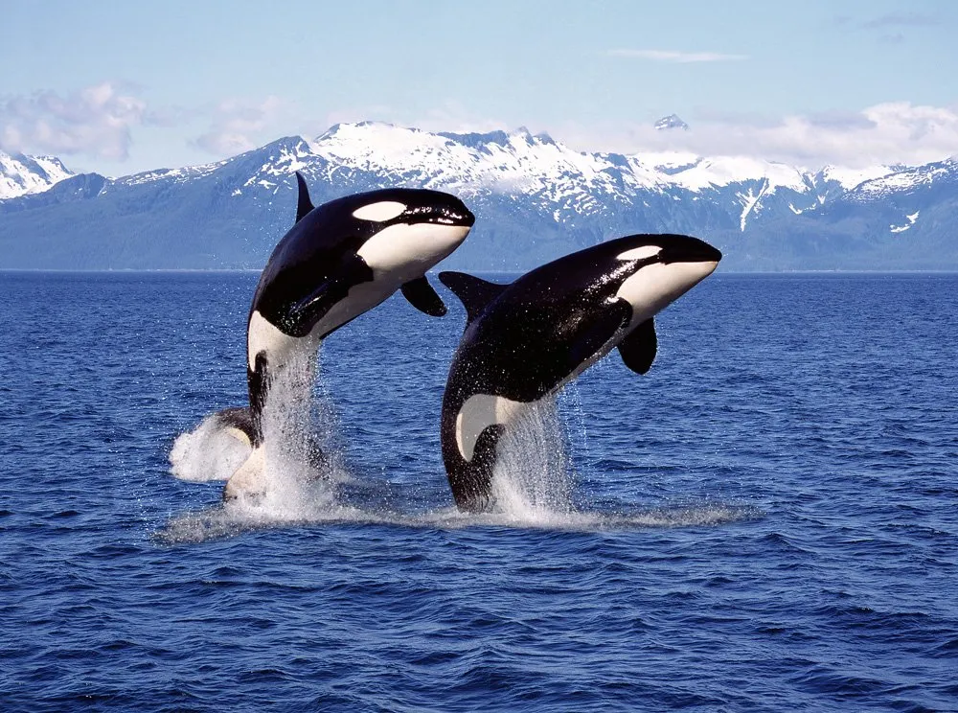
Notes:
orca

Slide 7
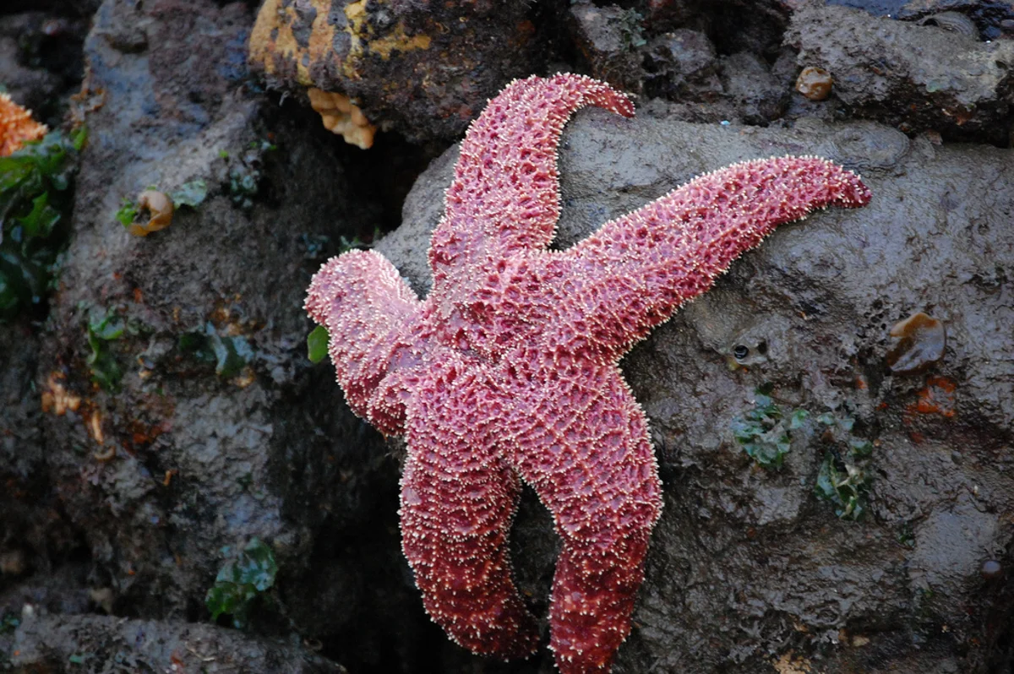
Notes:
starfish

Slide 8
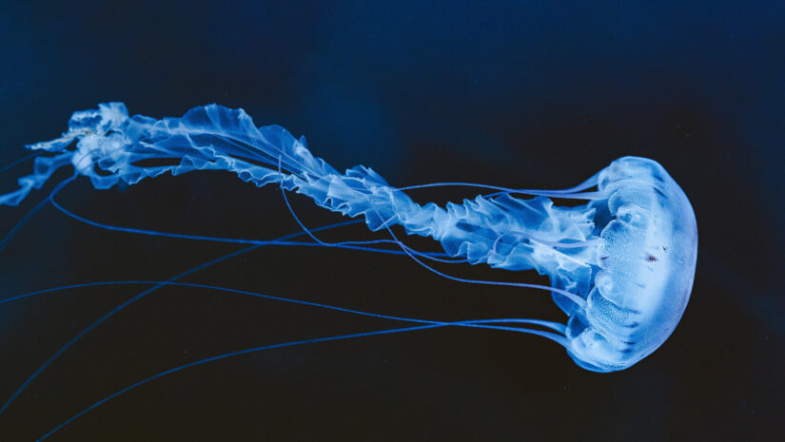
Notes:
jellyfish

Slide 9
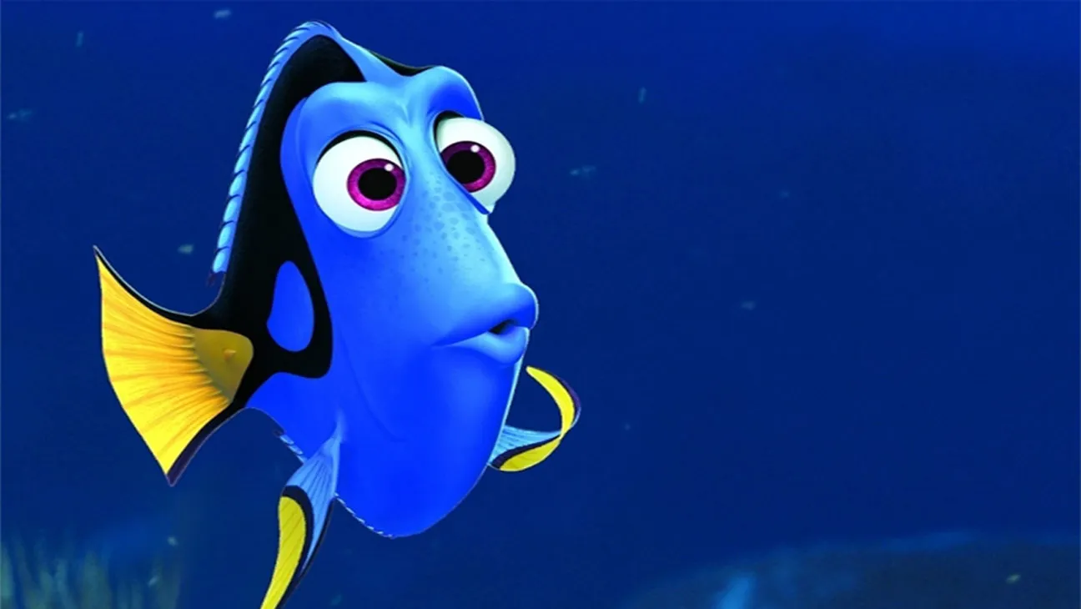
Notes:
Dory

Slide 10
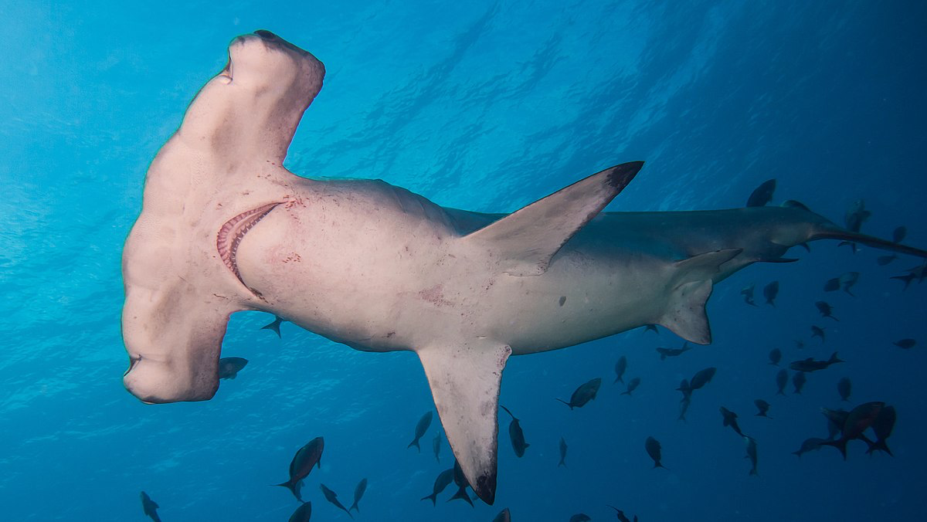
Notes:
Hammerhead shark

Slide 11
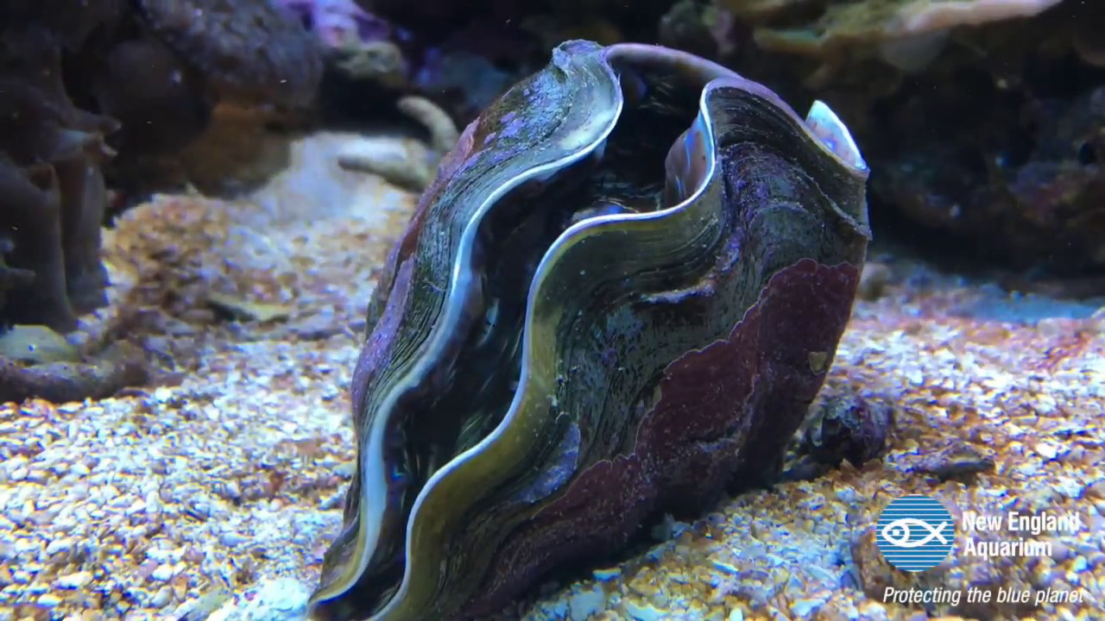
Notes:
Giant clam

Slide 12
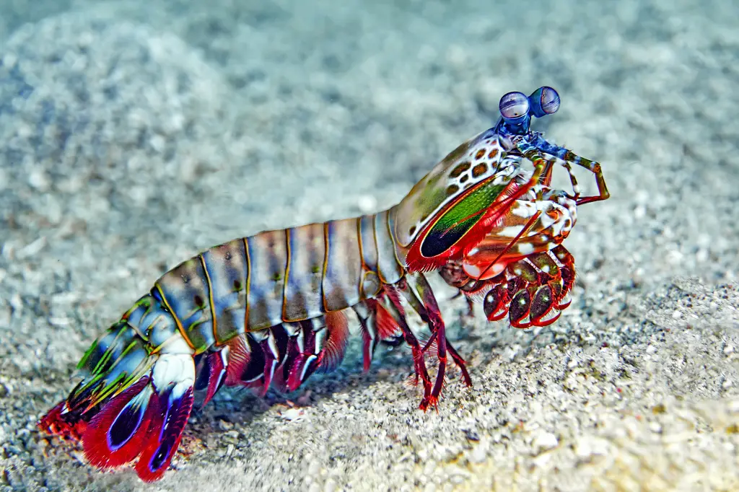
Notes:
Mantis shrimp

Slide 13
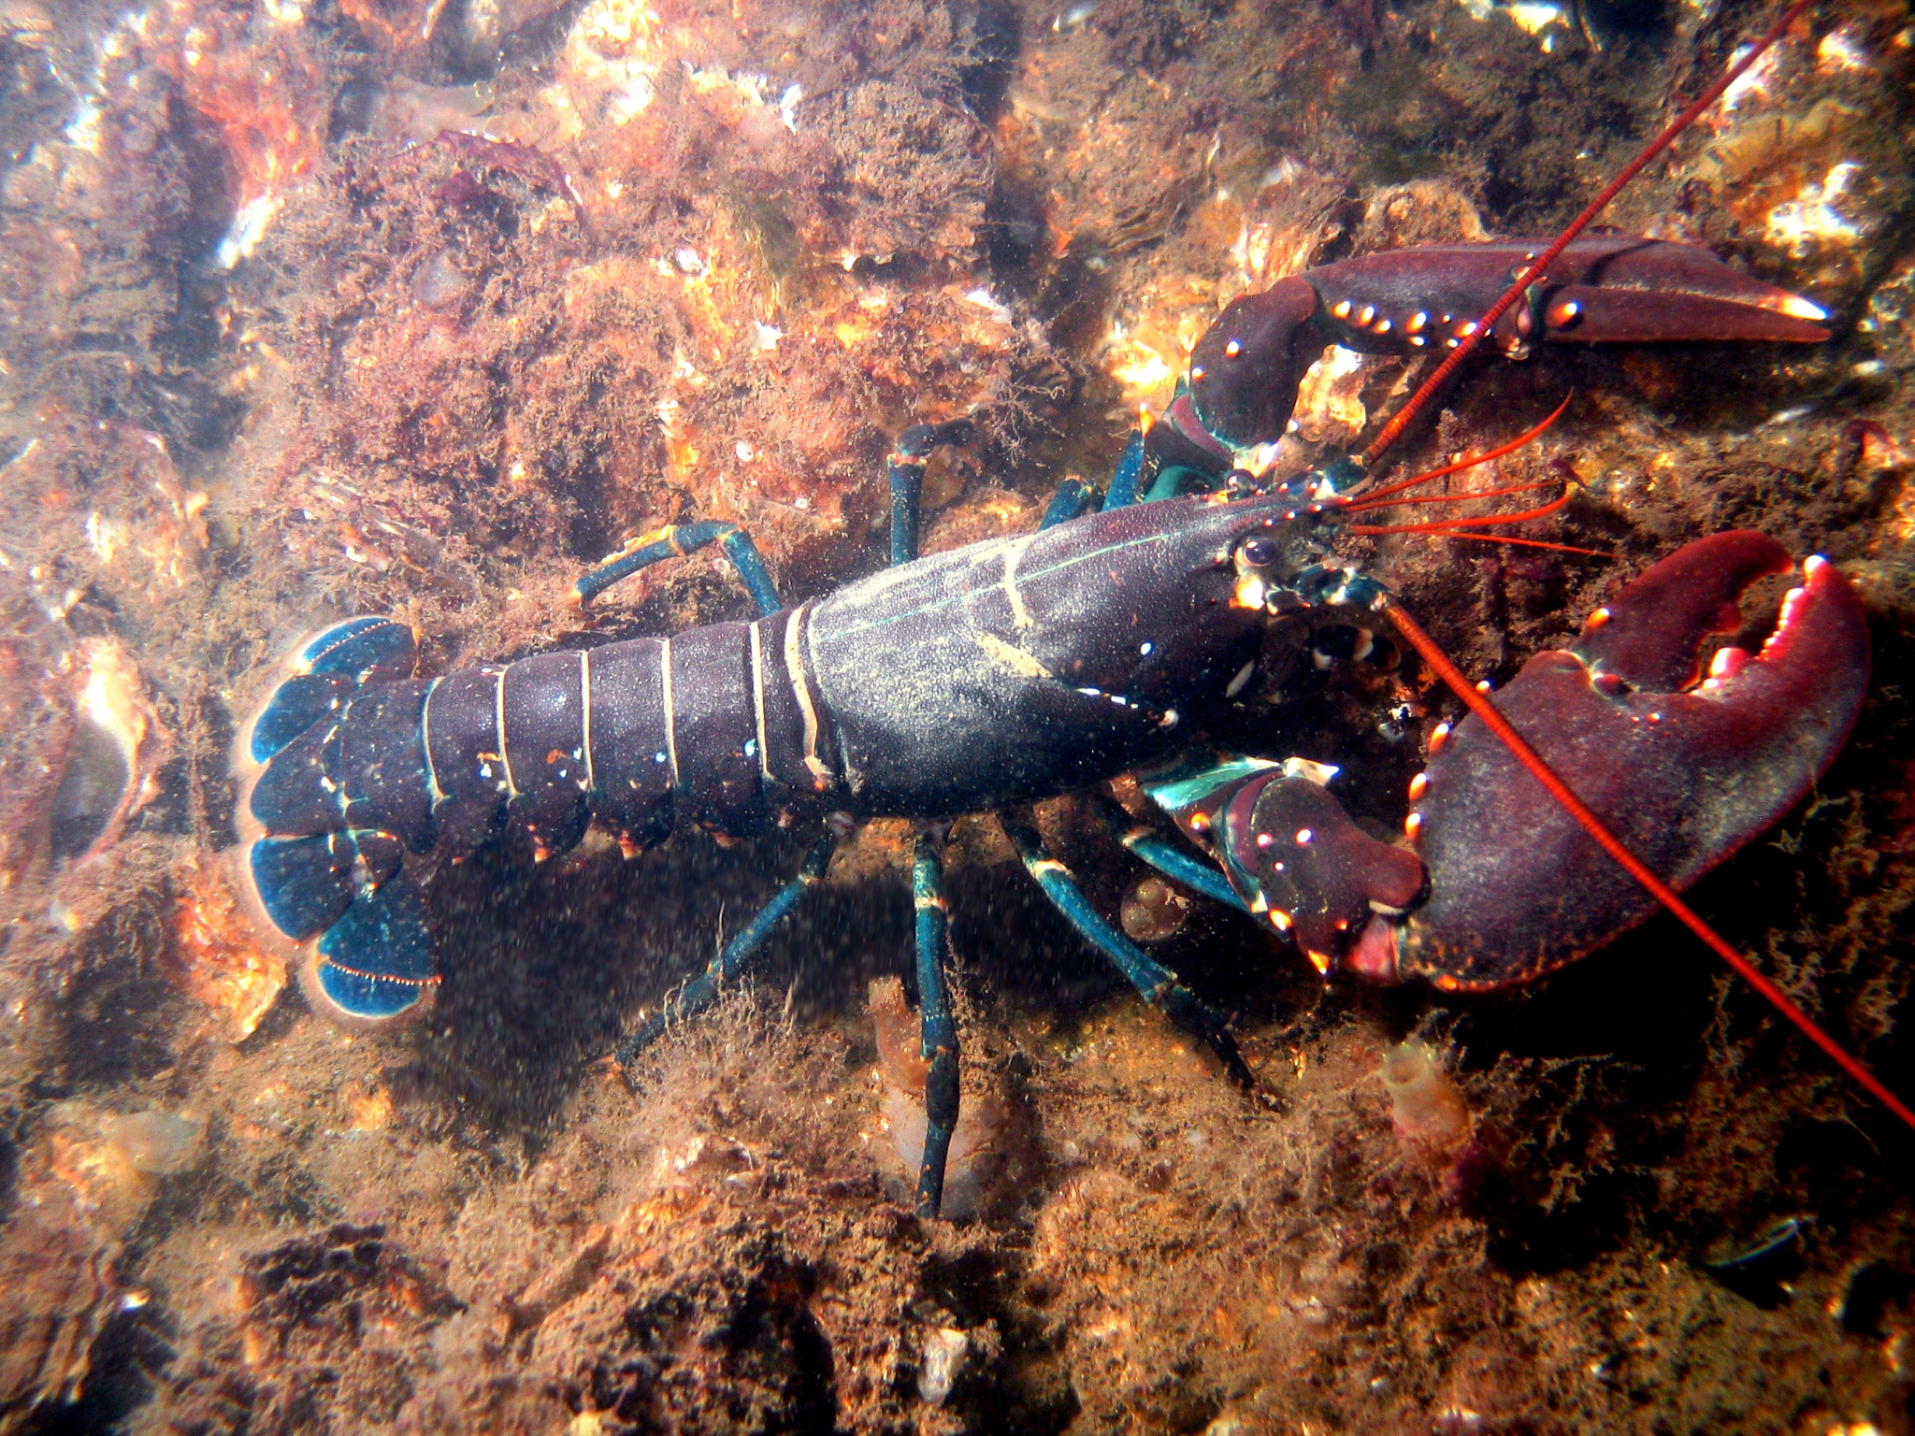
Notes:
lobster

Slide 14
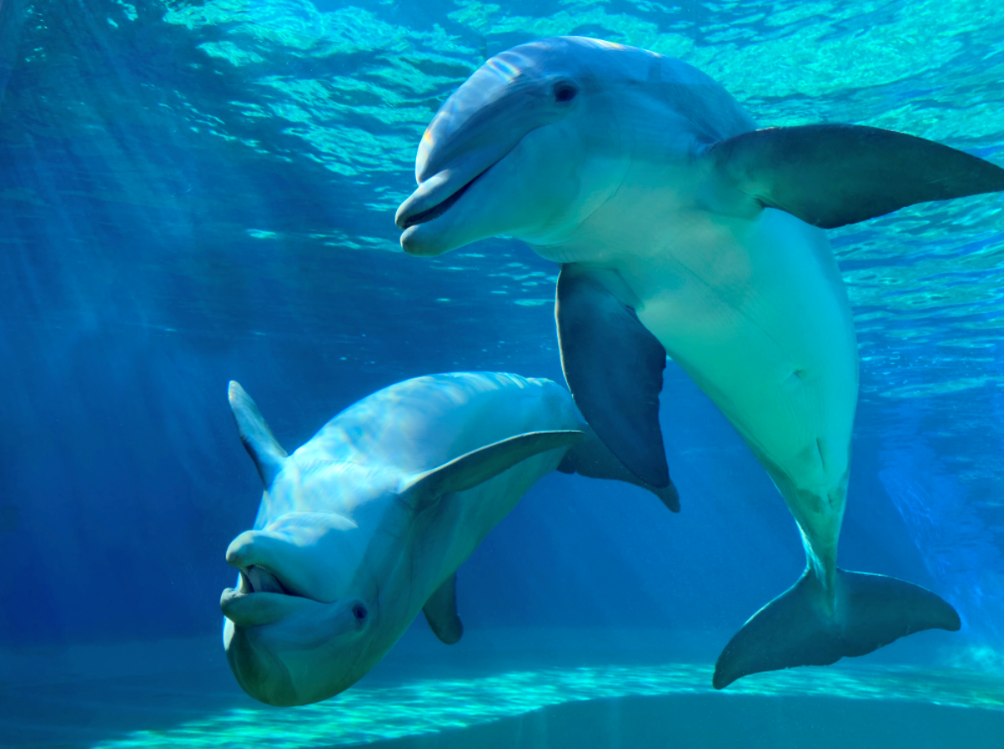
Notes:
dolphin

Slide 15
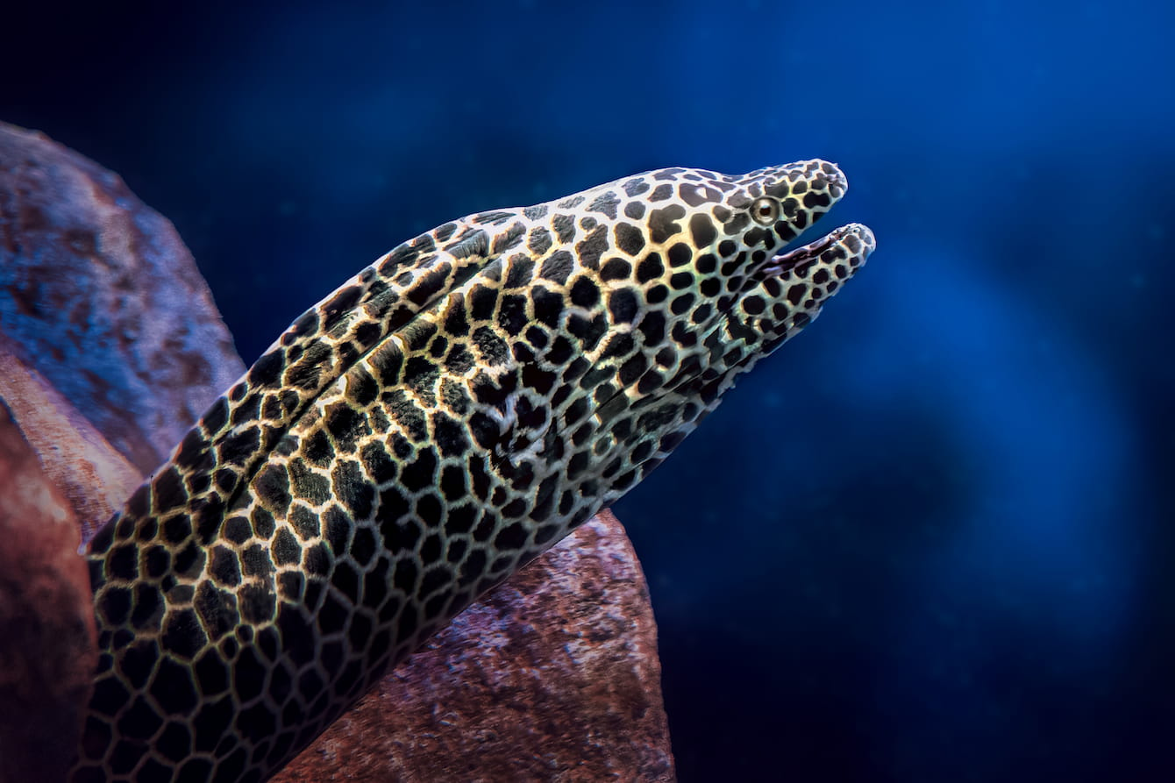
Notes:
(Moray) eel

Slide 16

Notes:
Sharkboy

Slide 17
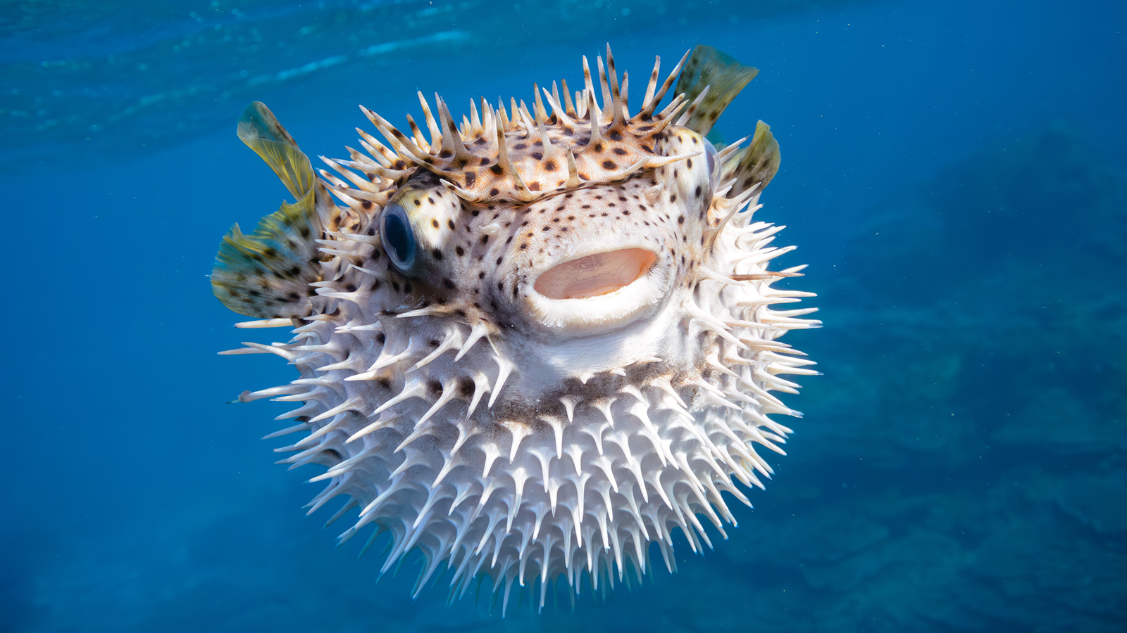
Notes:
pufferfish

Slide 18
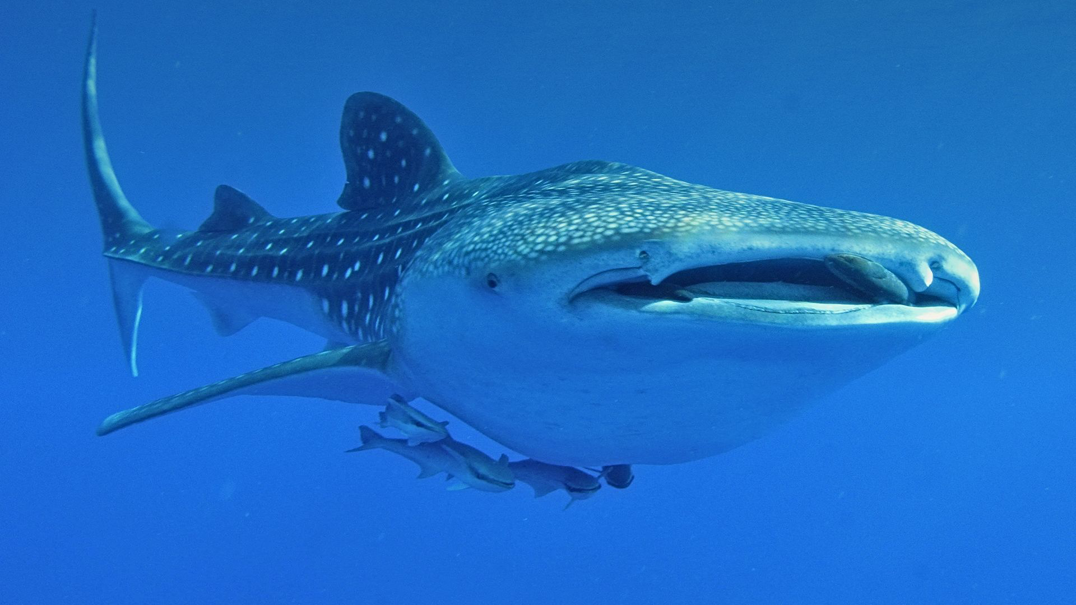
Notes:
Whale shark

Slide 19
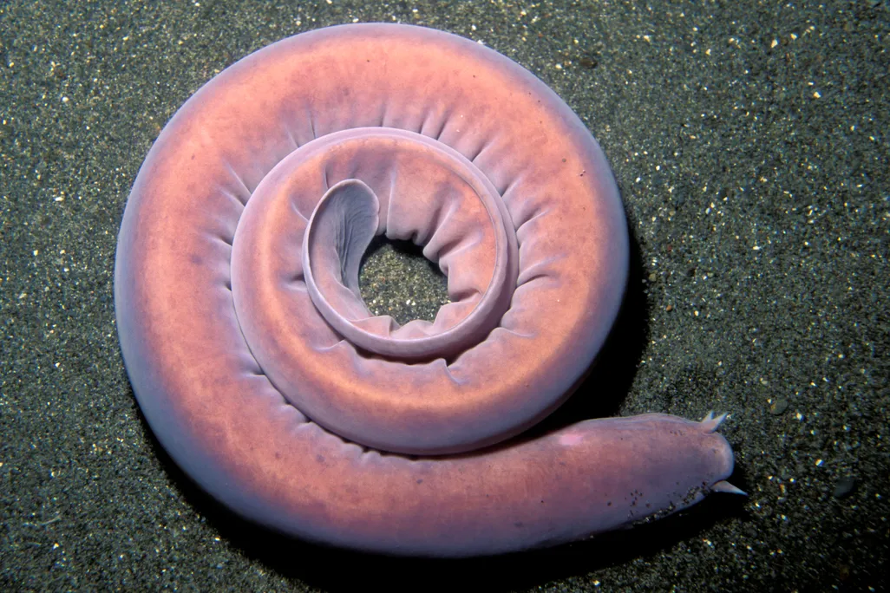
Notes:
hagfish

Slide 20
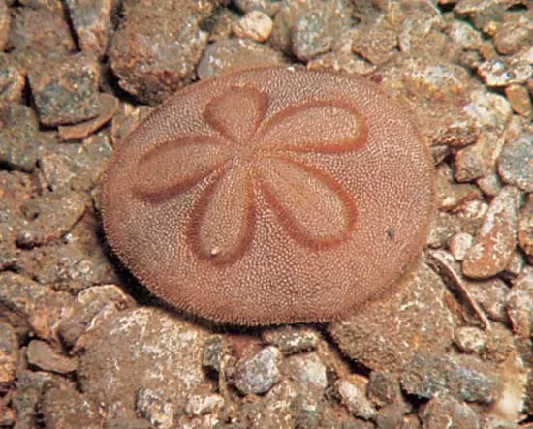
Notes:
Sand dollar

Slide 21
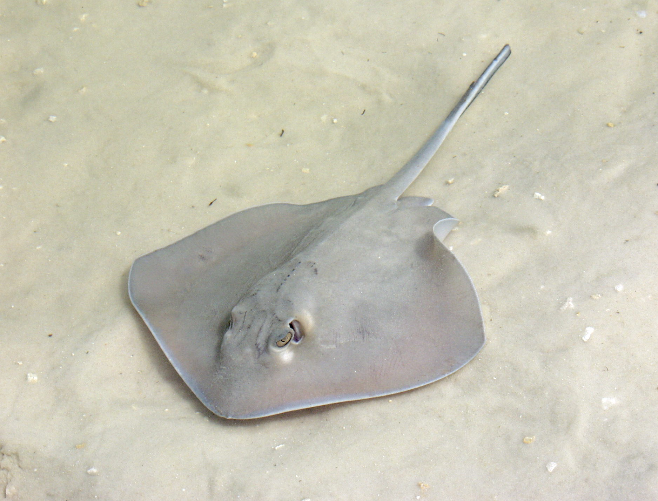
Notes:
Sting ray

Slide 22
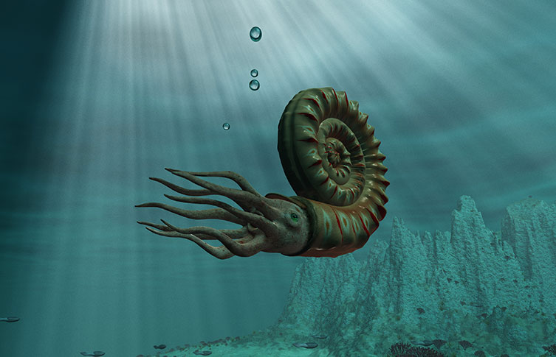
Notes:
ammonite

Slide 23

Notes:
aquaman

Slide 24
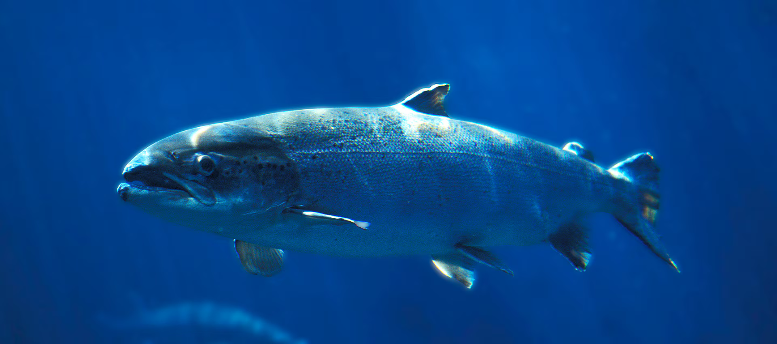
Notes:
salmon

Slide 25
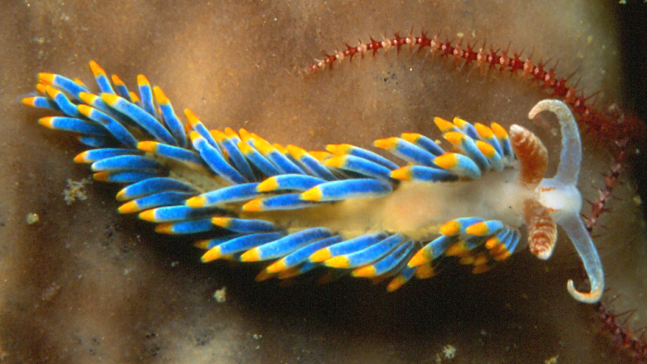
Notes:
Nudibranch (sea slug)

Slide 26
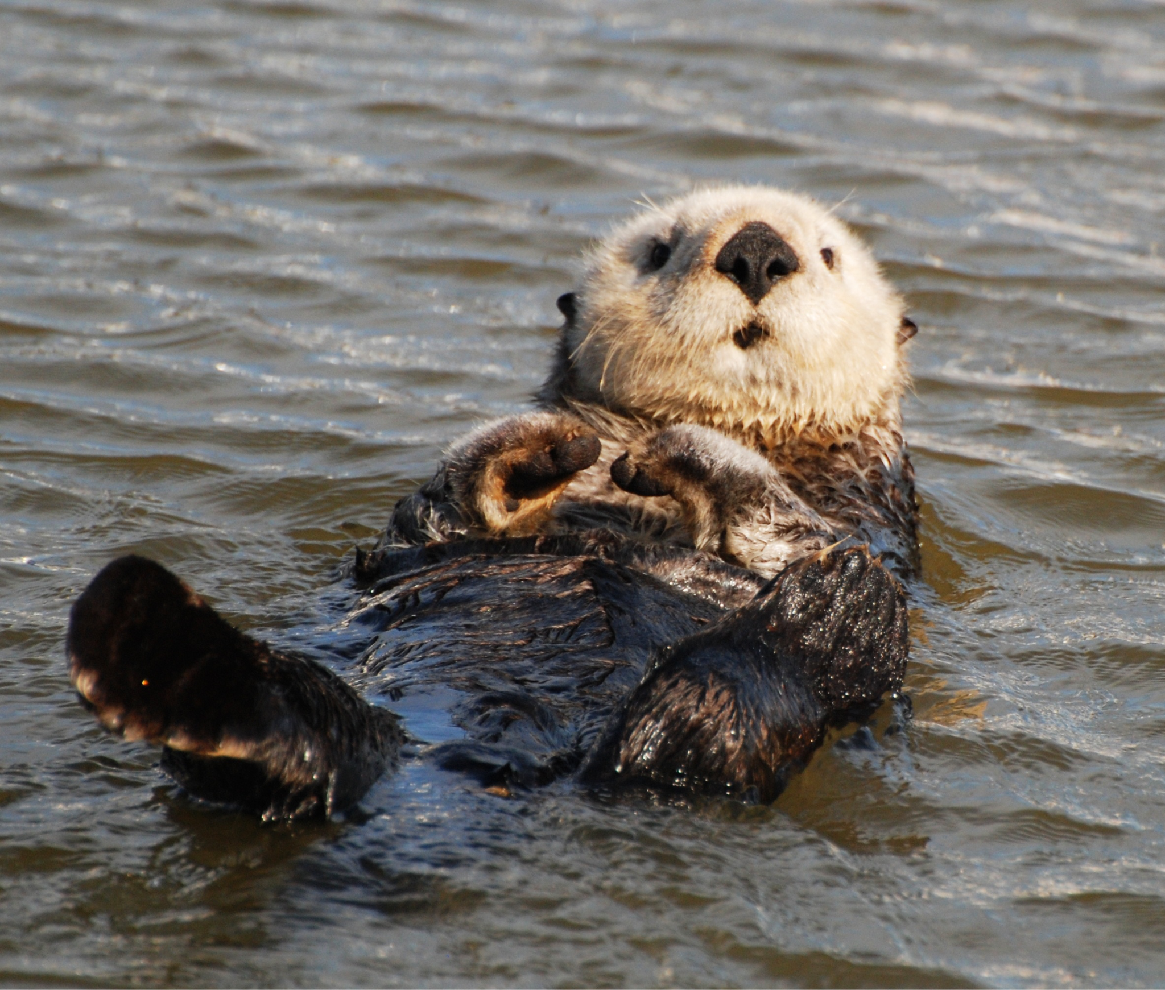
Notes:
Sea otter

Slide 27
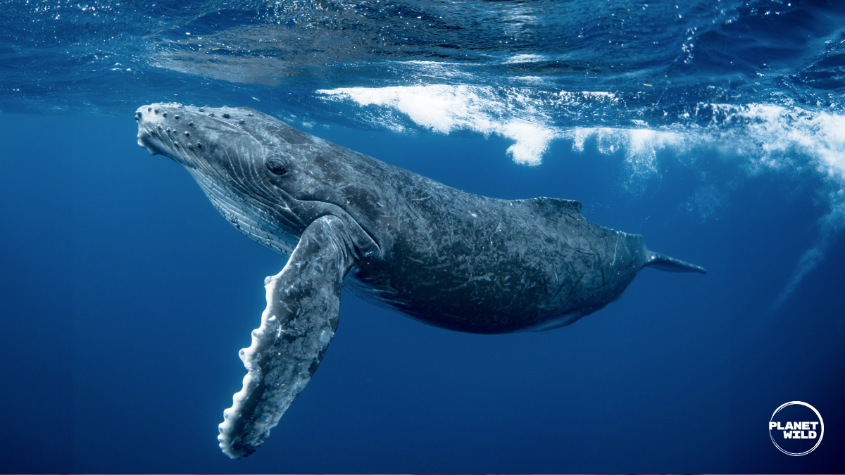
Notes:
Blue whale

Slide 28
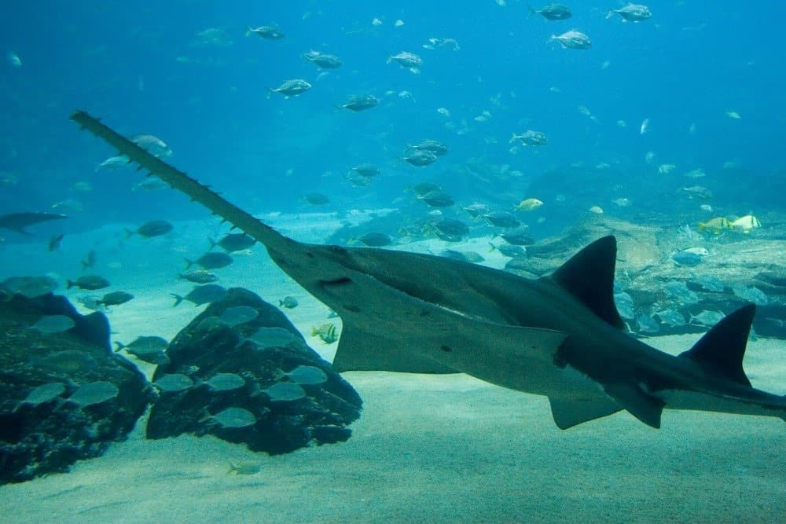
Notes:
sawfish

Slide 29
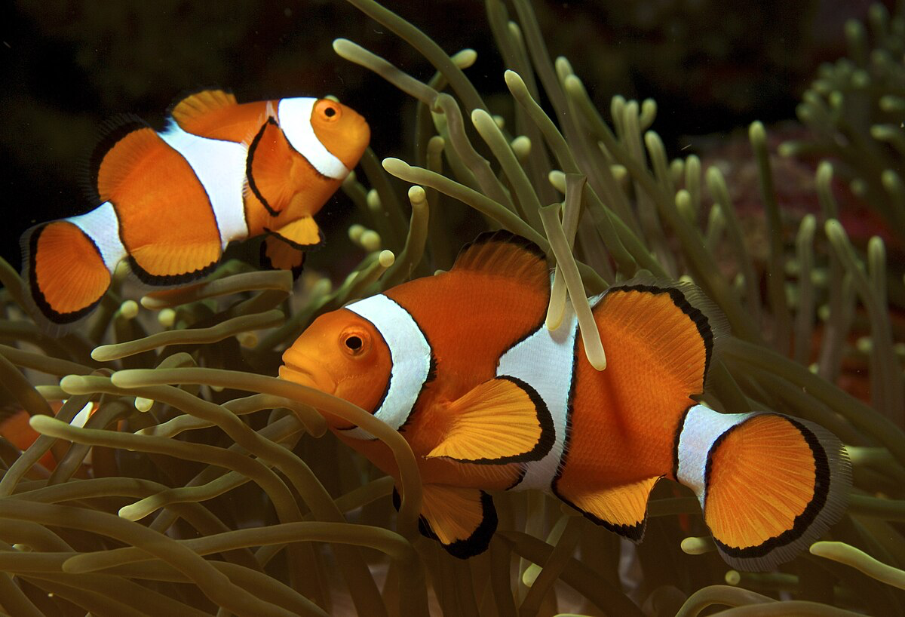

Slide 30
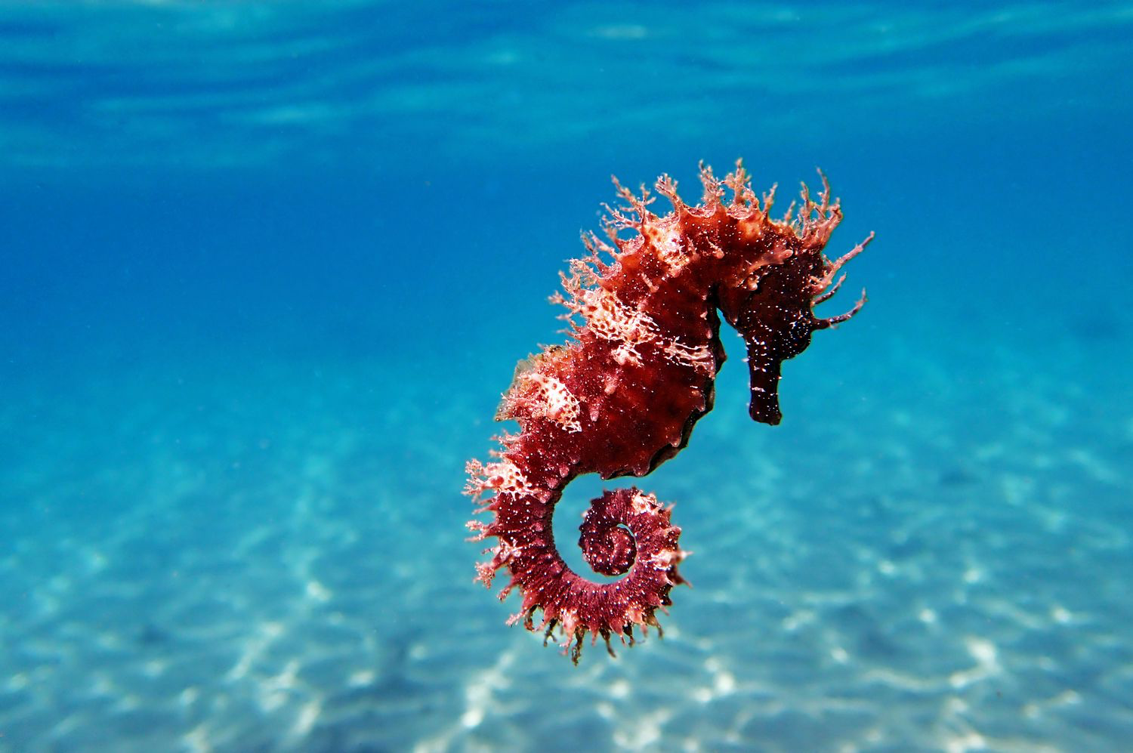
Notes:
Sea horse

Slide 31
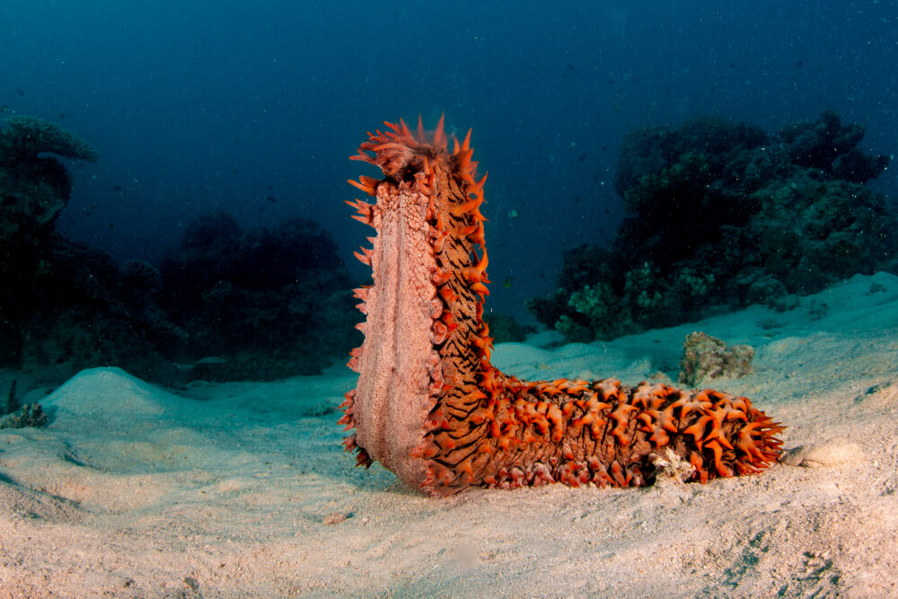
Notes:
Sea cucumber

Slide 32
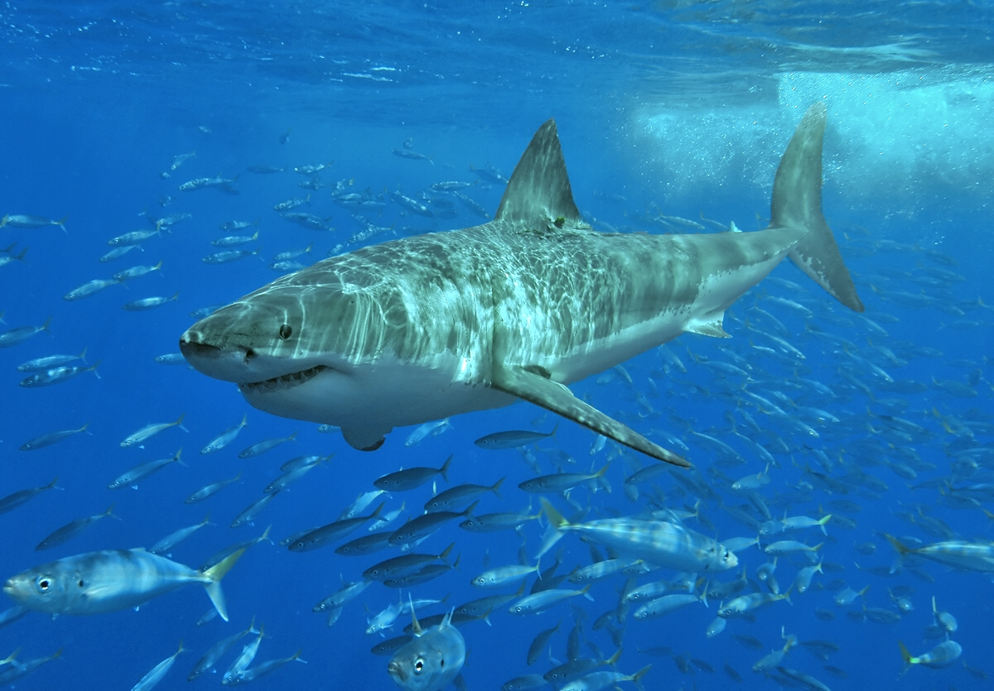
Notes:
Great white shark

Slide 33
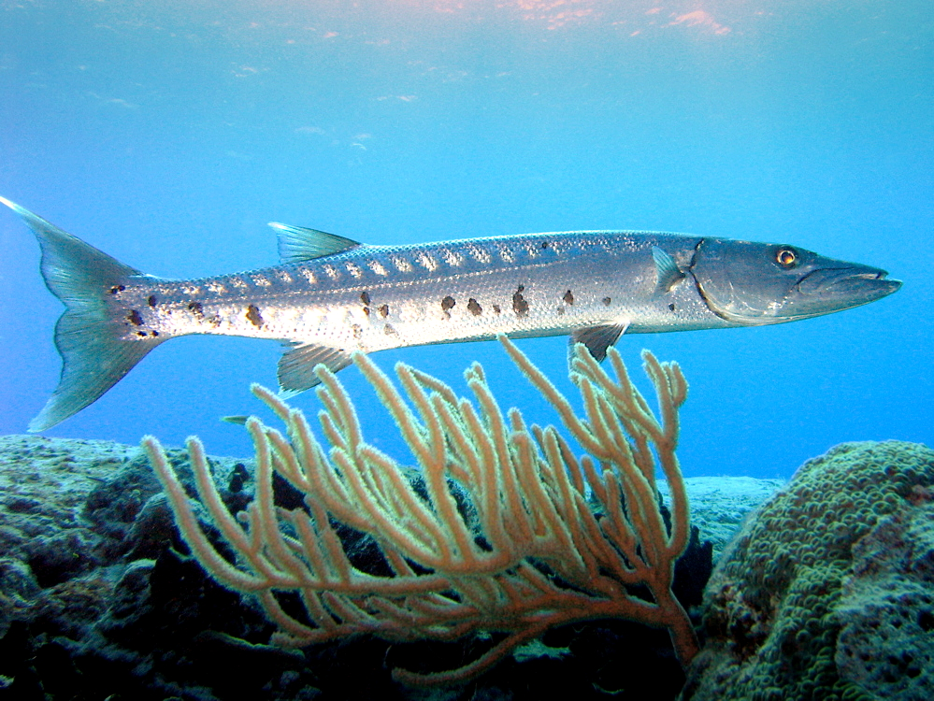
Notes:
barracuda

Slide 34
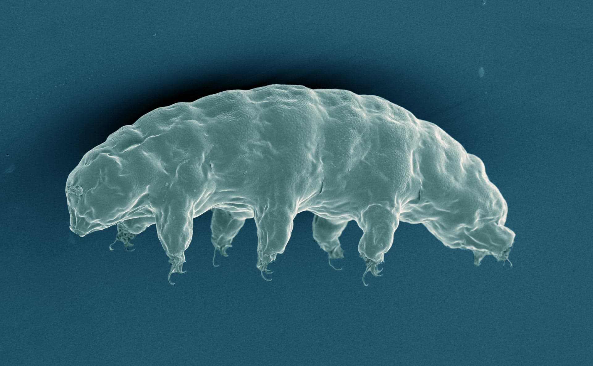
Notes:
tardigrade

Slide 35
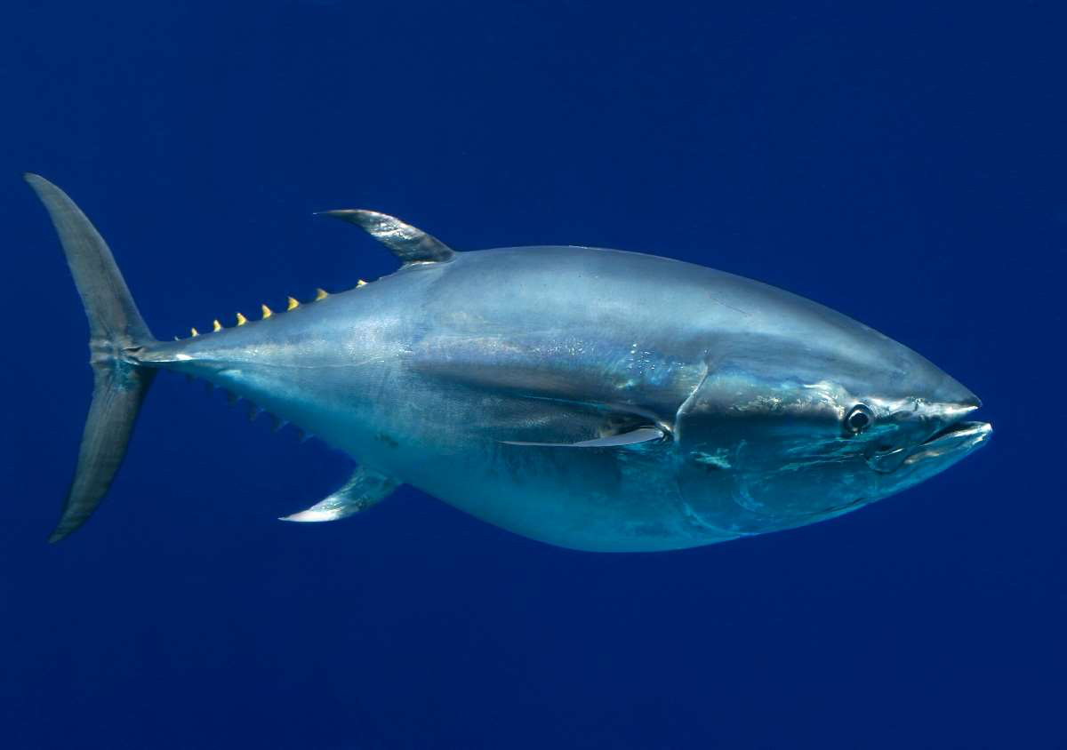
Notes:
tuna

Slide 36
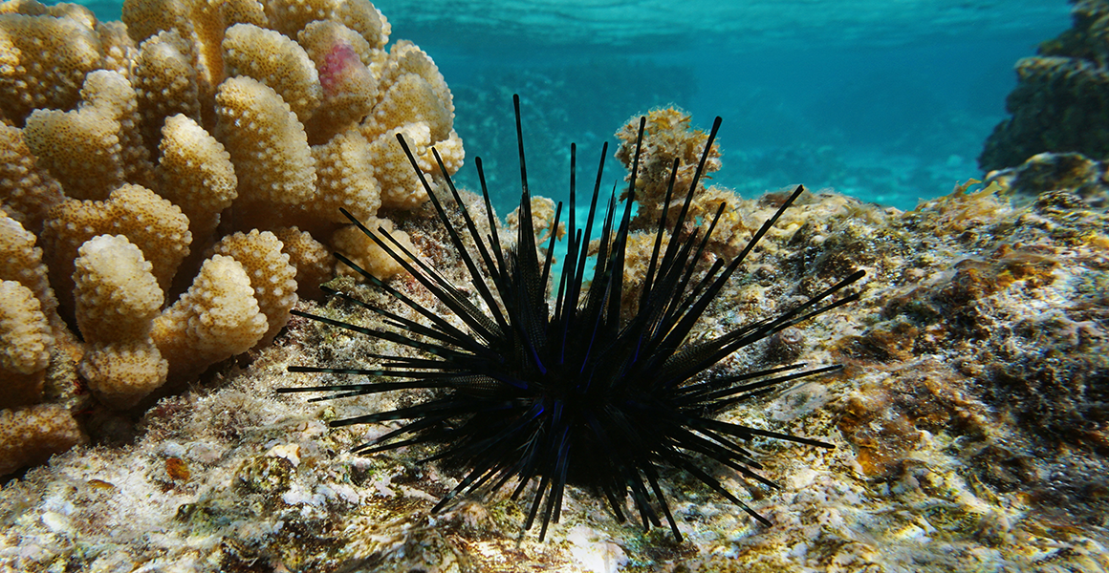
Notes:
Sea urchin

Slide 37
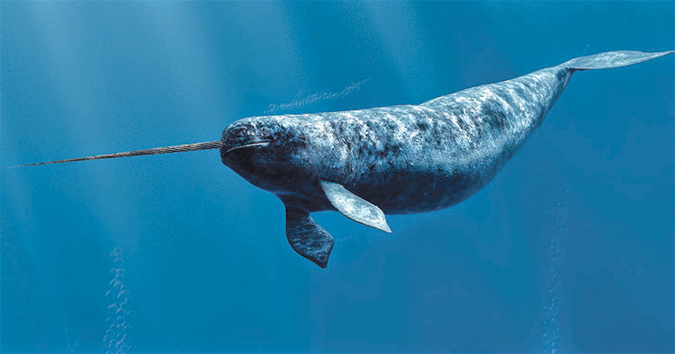
Notes:
narwhal

Slide 38
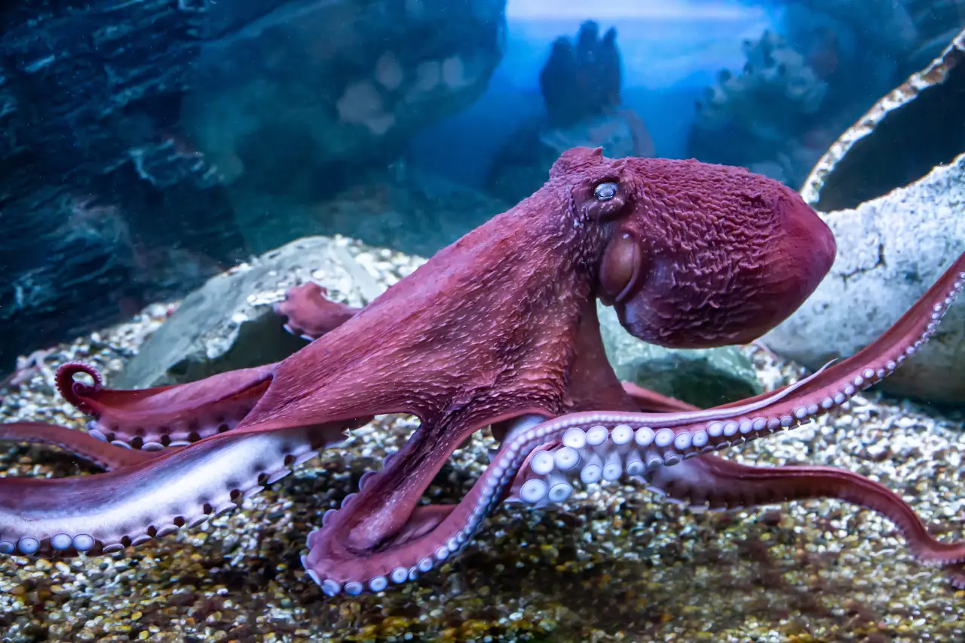
Notes:
octopus

Slide 39
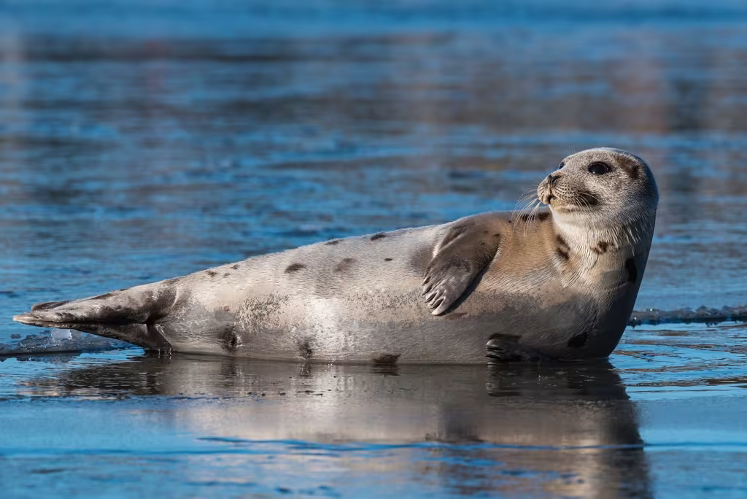
Notes:
seal

Slide 40
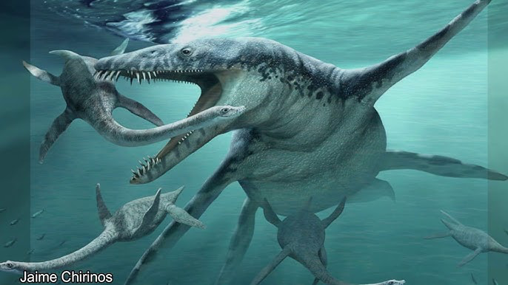
Notes:
Liopleurodon

Slide 41

Notes:
Spongebob squarepants

Slide 42
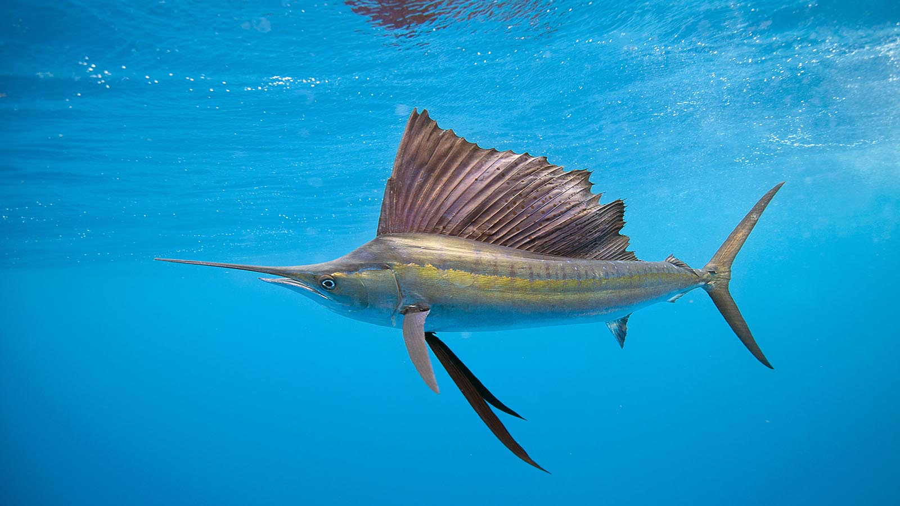
Notes:
sailfish

Slide 43
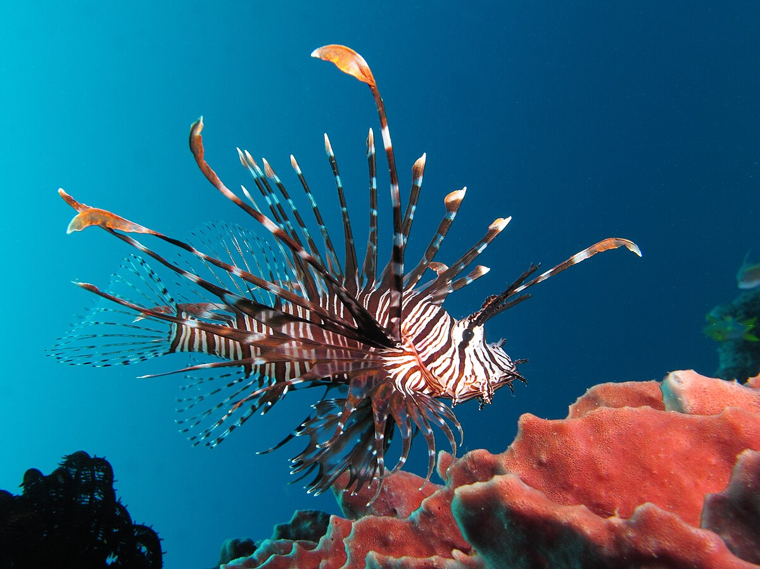
Notes:
Lionfish

Slide 44
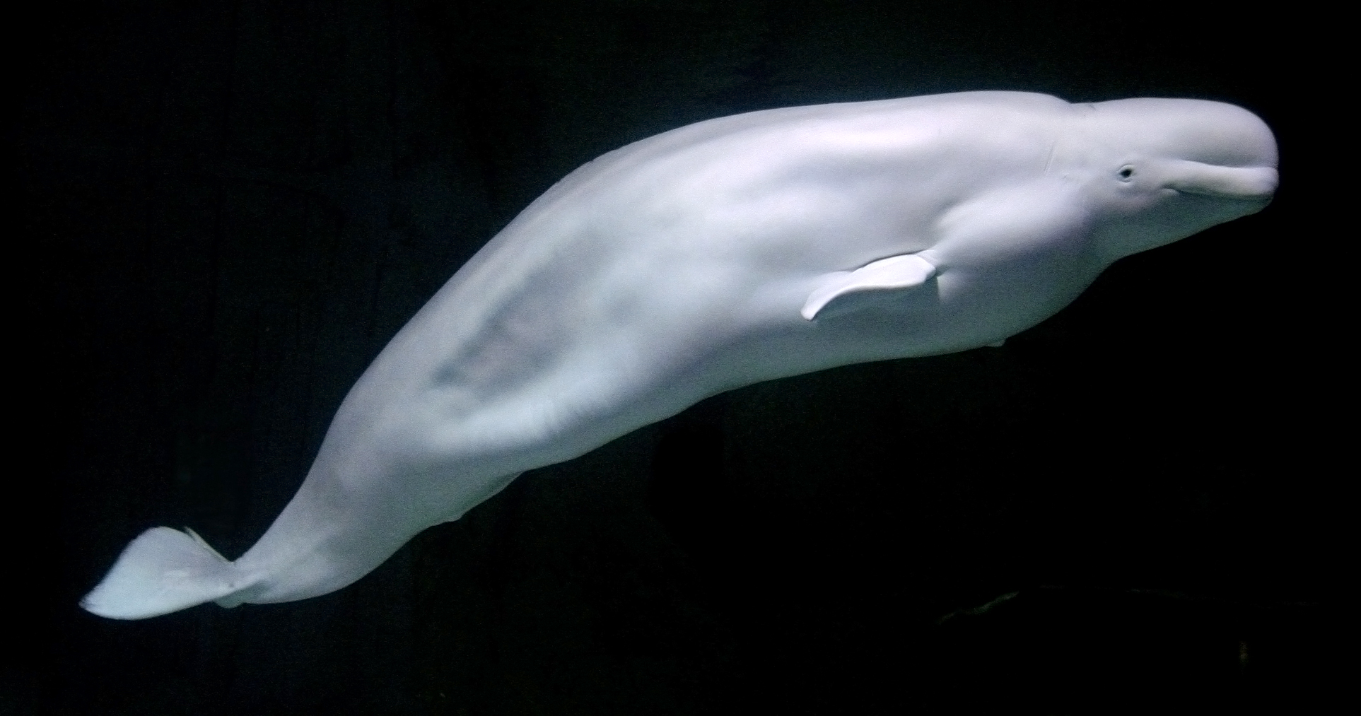
Notes:
beluga

Slide 45
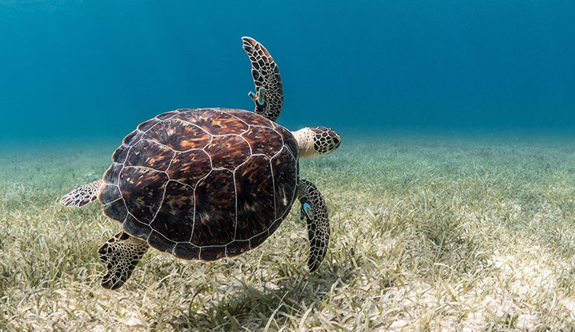
Notes:
Sea turtle

Slide 46
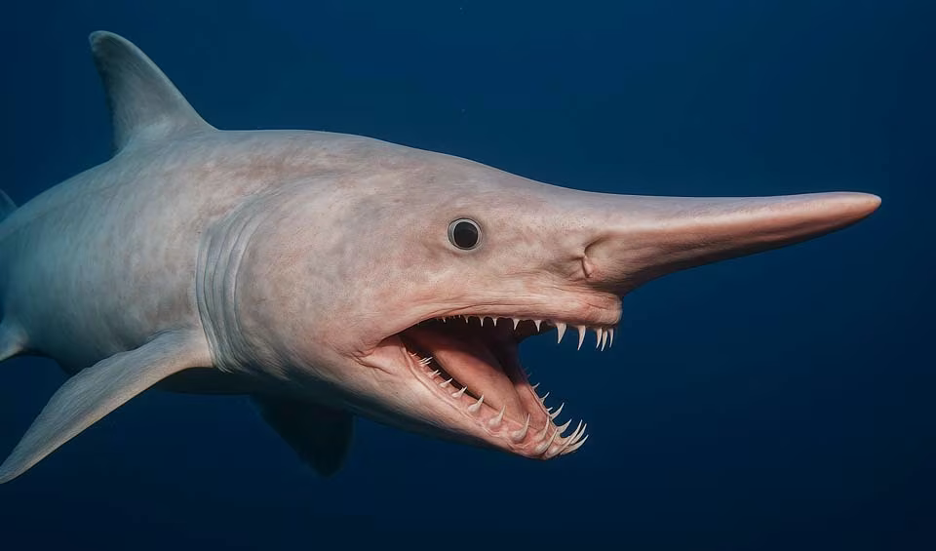
Notes:
Goblin shark

Slide 47
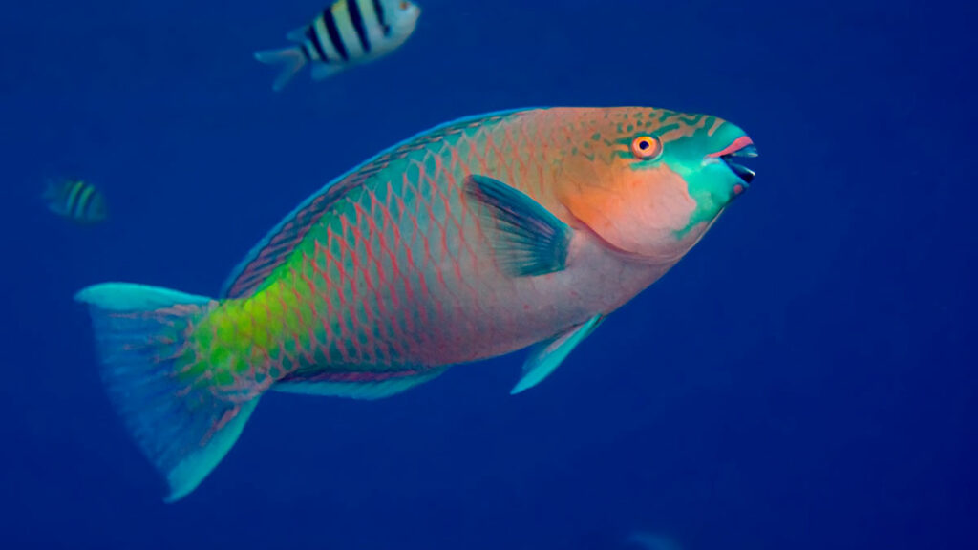
Notes:
parrotfish

Slide 48
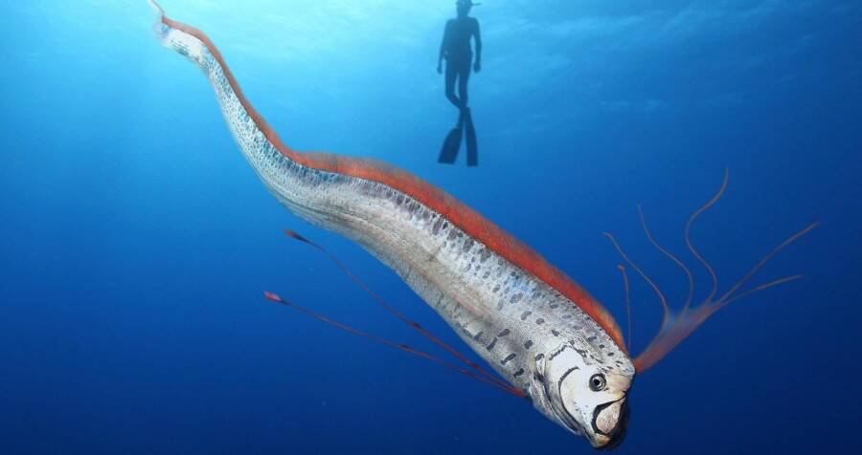
Notes:
oarfish

Slide 49
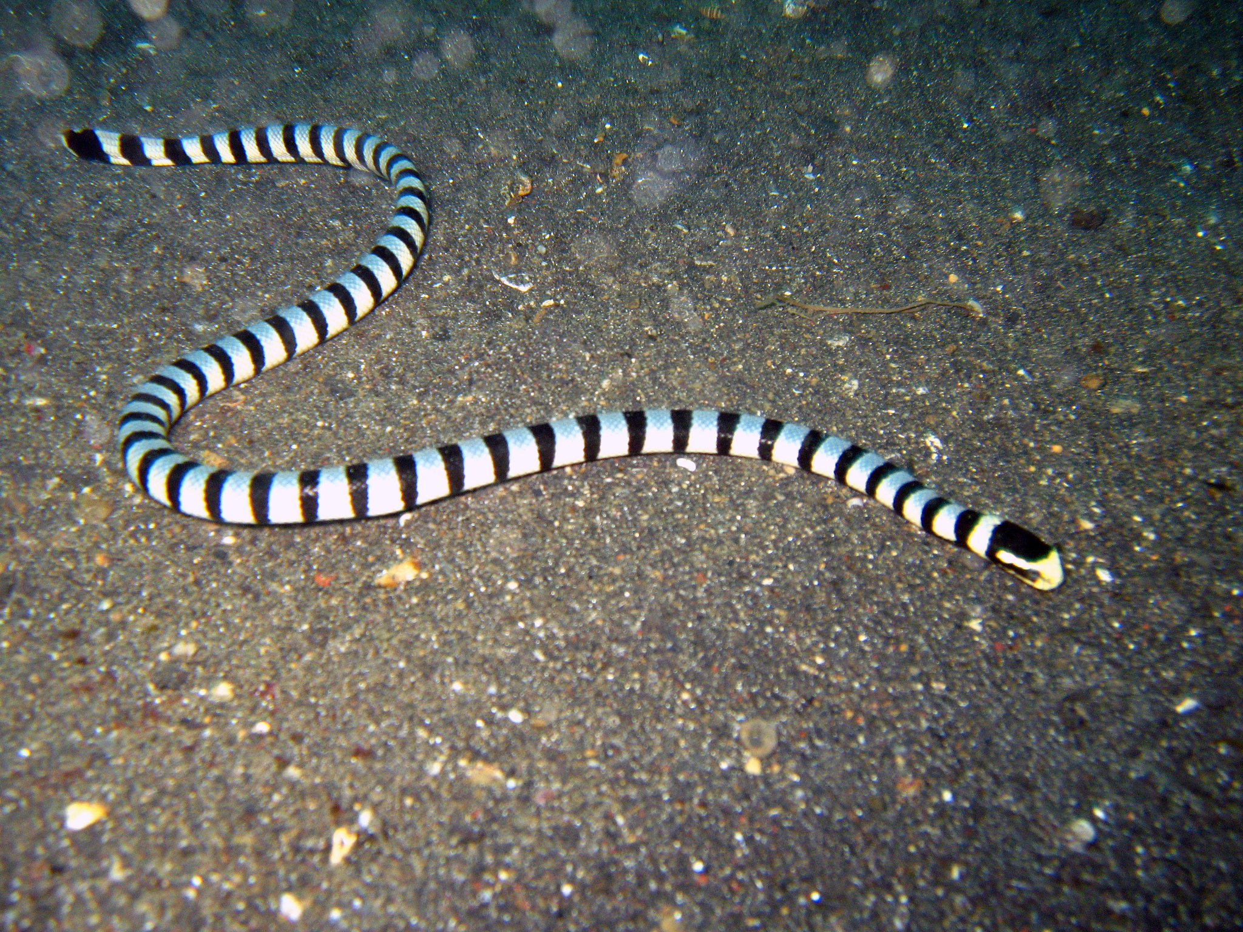
Notes:
Sea snake

Slide 50
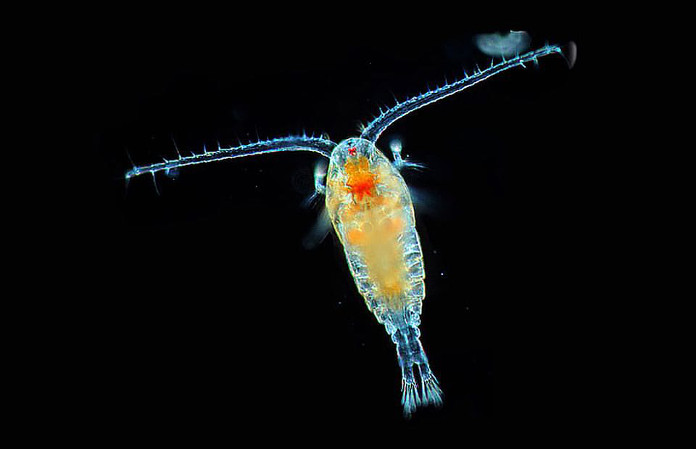
Notes:
plankton

